Slide 1

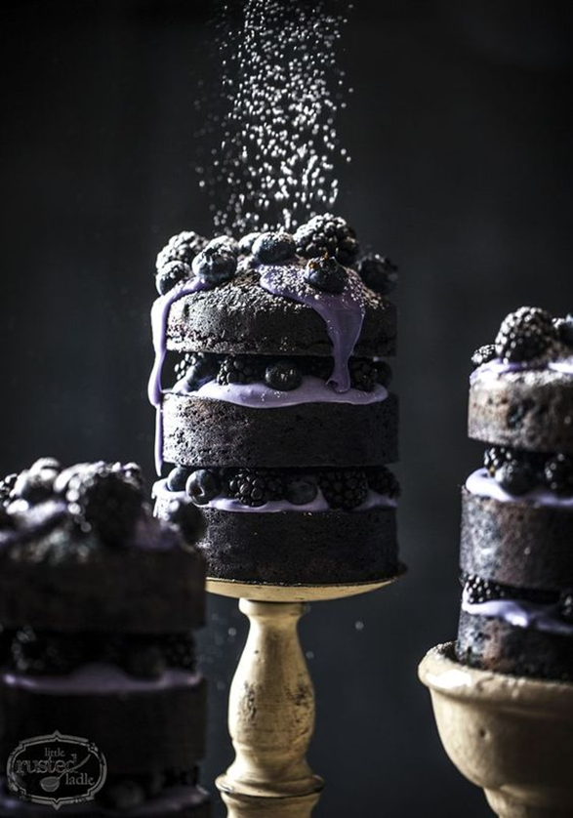
Food Photography
Career
Considerations
Jean Lunde

Slide 2
Food Photography, Description
Food photography is a still life photography genre used to create attractive still life photographs of food. It is a specialization of commercial photography, the products of which are used in advertisements, magazines, packaging, menus or cookbooks. Professional food photography is a collaborative effort, usually involving an art director, a photographer, a food stylist, a prop stylist and their assistants.
A food photographer often marries a culinary background with a strong photographic background.

Slide 3
Food Photography, Salary Information
The following figures are taken directly from the United States Department of Labor Bureau of Labor Statistics. Unfortunately, the Bureau does not have a unique category for food photographers. Most food photographers are self-employed, making it difficult to derive those figures. The figures you see represent the salaries of photographers as a whole. Data is available, however, by industry profile.

Slide 4
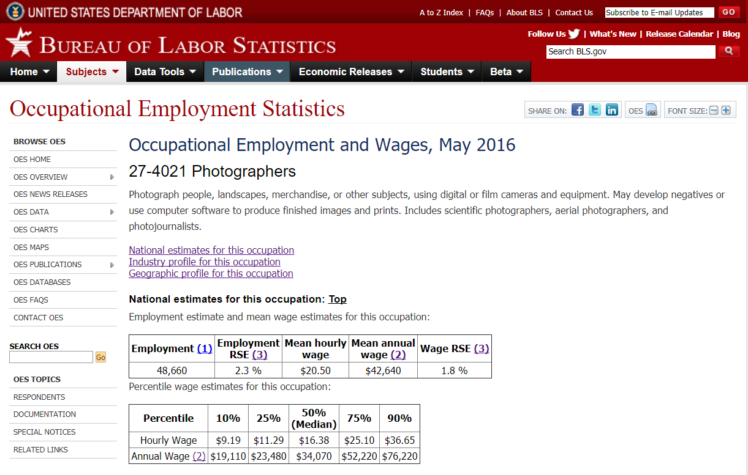
National Employment and Mean Wage Estimates for Photographers, May 2016
https://www.bls.gov/oes/current/oes274021.htm#nat

Slide 5
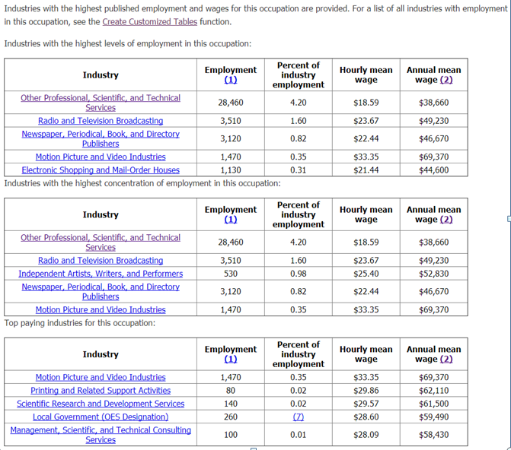
Industry Profile for Photographers
https://www.bls.gov/oes/current/oes274021.htm#nat

Slide 6
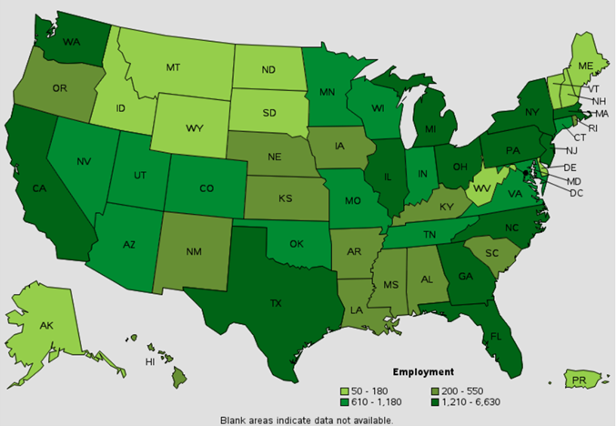
Employment Comparison for Photographers by State, May 2016
https://www.bls.gov/oes/current/oes274021.htm#nat

Slide 7
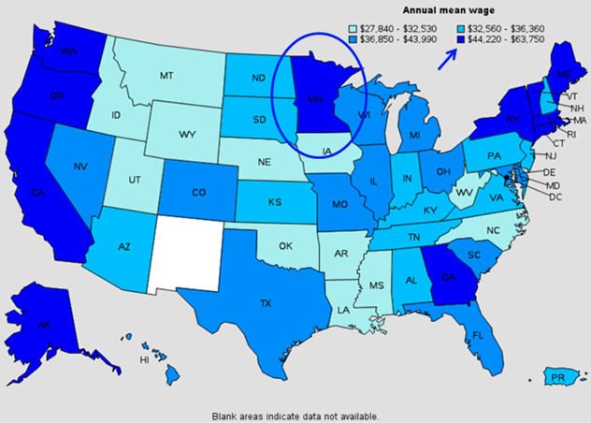
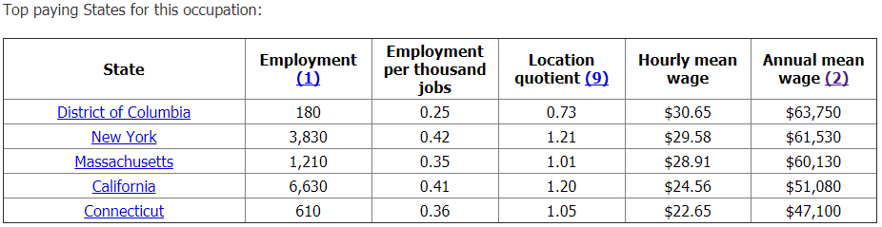
Annual Mean Wage of Photographers by State, May 2016
Note that Minnesota ranks among the states paying the highest photographer wages (although it doesn’t make the top five list.)
https://www.bls.gov/oes/current/oes274021.htm#nat

Slide 8
Salary Data, Other Sources
According to Indeed.com, the average annual salary for food photographers is $42,000. The rates charged are determined by the photographer's level of experience and expertise. The average hourly rate for new food photographers may range from $120 to $250, depending on location and type of assignment.
http://work.chron.com/starting-wage-food-photographer-20279.html

Slide 9
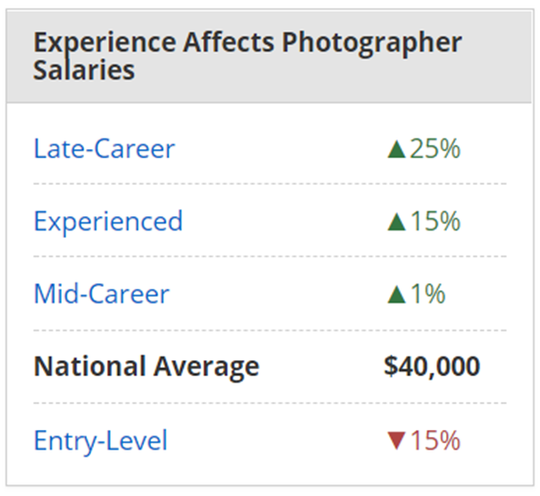
Effect of Experience on Salary
A food photographer with ten years of experience might expect a 15 – 25% increase in salary as shown below.
https://www.payscale.com/research/US/Job=Photographer/Salary

Slide 10
Food Photography, Skill Set
Food photographers should be creative and detail oriented. They should be experienced in the use of digital cameras, printing, and computer editing software. A knowledge of business and marketing as well as good interpersonal skills can help them succeed in the field.
https://study.com/articles/Food_Photographer_Job_Description_and_Career_Roadmap.html

Slide 11
Seven Skills to Master
Skill # 1 – Understanding Composition
Skill # 2 – Understanding Light
Skill # 3 – Telling a Story
Skill # 4 – Setting the Scene
Skill # 5 – Choosing and Using Props
Skill # 6 – Styling the Food
Skill # 7 – Post Processing
http://www.learnfoodphotography.com/eofp-lesson-1/

Slide 12
Food Photography, Working Conditions
A food photographer:
Typically works within his own studio or a client's studio
Occasionally does photo shoots at alternate location
Deals sometimes with stressful client deadlines
Strives for perfectionism until he gets a photo just right

Slide 13
Food Photography, Tricks of the Trade
If the food photographer functions as his own food stylist, he may employ an arsenal of tools not normally associated with food to masterfully deceive his audience. A food lover might be repulsed if he knew what he was actually looking at in a photo.
Due to the perishable nature of food, the food photographer sometimes uses fake replacements for real food. For example:
Acrylic cubes in place of ice cubes
Mashed potatoes or lard in place of ice cream
Glycerin in place of water drops on a beer bottle
Elmer’s glue in place of milk to avoid sogginess

Slide 14
He uses various substances to enhance appearance, such as:
Hair spray on half-cooked green beans to make them moist and shiny
Shaving cream instead of whipped cream to better hold a desired shape
Super glue to mend the tears on a turkey’s skin, then a mixture of inedible substances to paint on the turkey to give it a roasted look

Slide 15
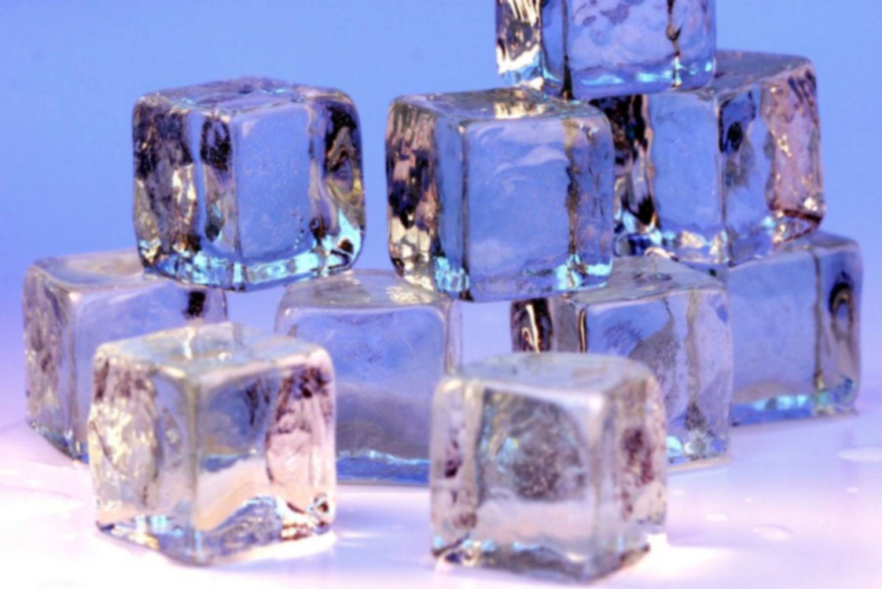
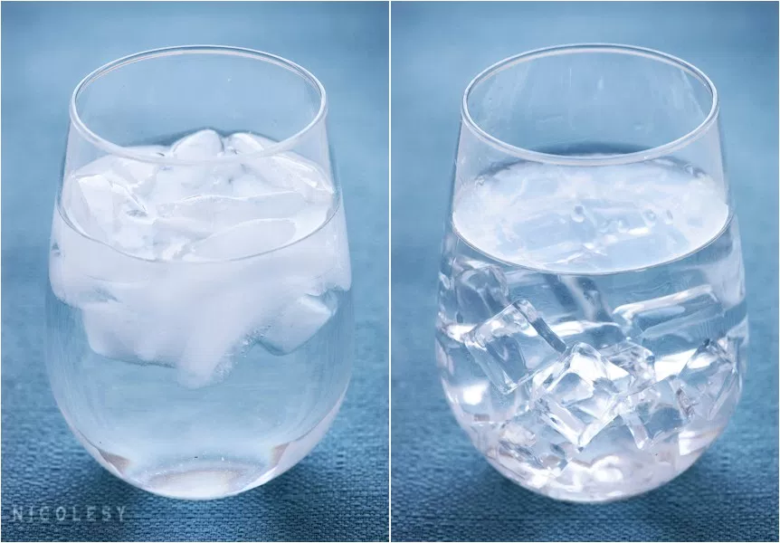

Slide 16
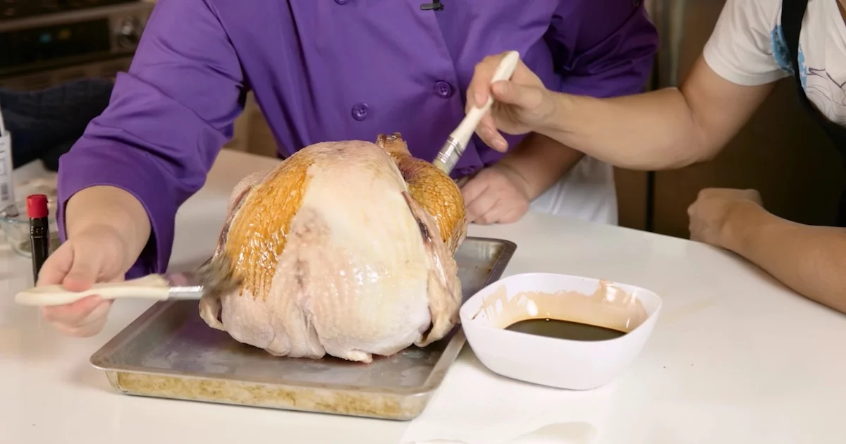
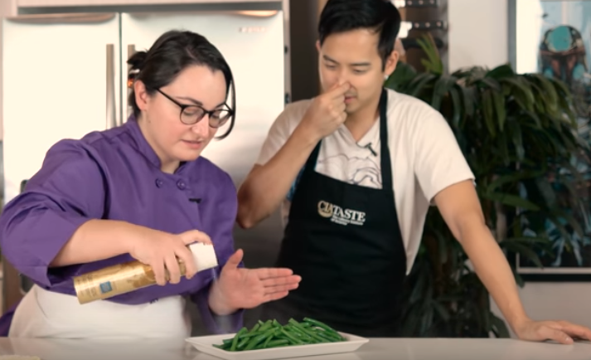
https://www.youtube.com/watch?v=IjvS4v2JVWo

Slide 17
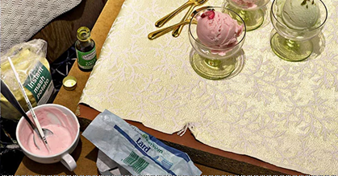
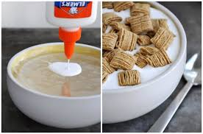
https://petapixel.com/2016/03/24/photos-show-secret-tricks-food-photography/

Slide 18
Food Photography, History and Trends
Until 30 years ago, food photos were documentary, serving as cooking guides and portraying recipe results.
New trends began to develop early in the ‘90s in Australia and Britain.
Pictures became crafted.
Interest increased in styling, atmosphere, and color.
Props became important elements.
A recent trend in food photography is ‘Gorgeous grey,’ which developed around 2015.
Grey is used in all its shades and variations.
Raw natural surfaces like slate, stone and wood are used.
Rough, bold surfaces enhance the appearance of food and make it appear delicate and graceful.
See examples of this trend in the next slides.
https://www.creativereview.co.uk/trends-modern-food-photography/?mm_5a70b8524da92=5a70b8524db35

Slide 19
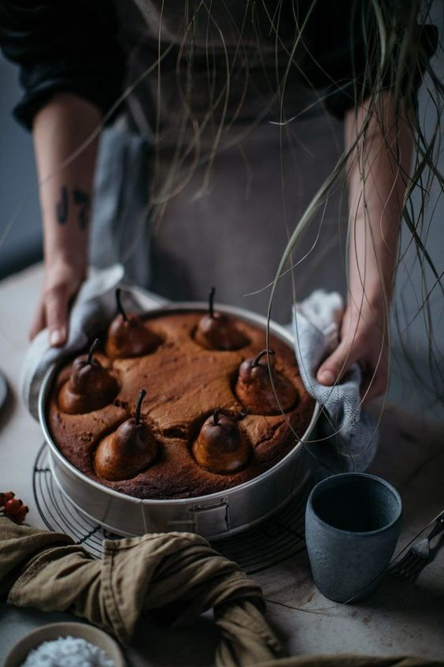
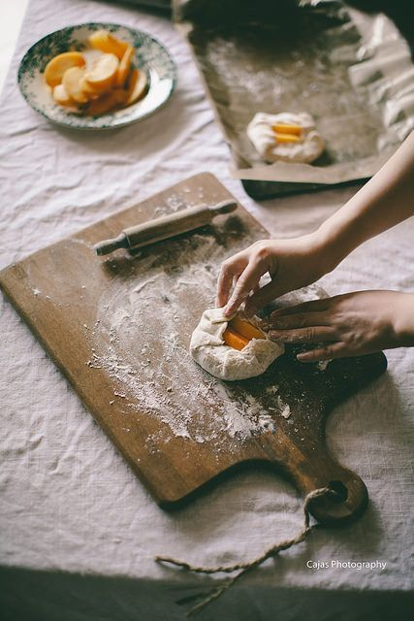

Slide 20
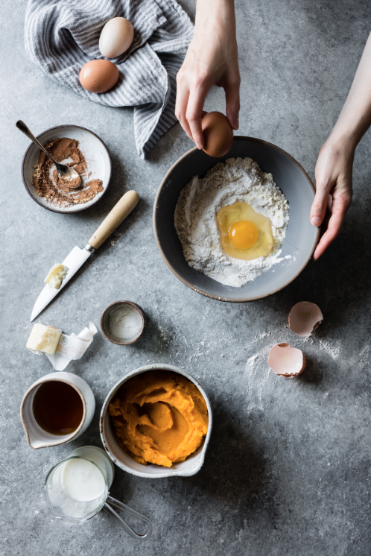
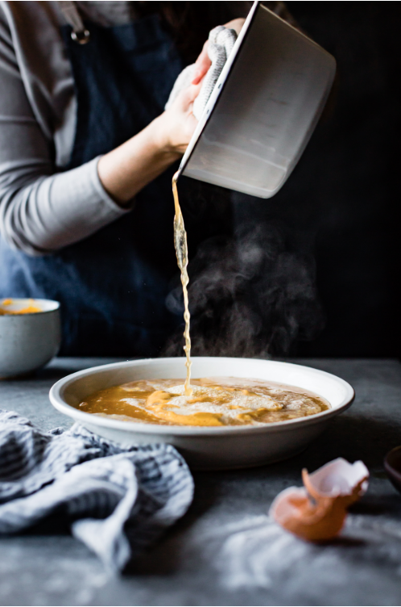
http://bojongourmet.com/2017/11/gluten-free-maple-pumpkin-pudding-chomeur/

Slide 21
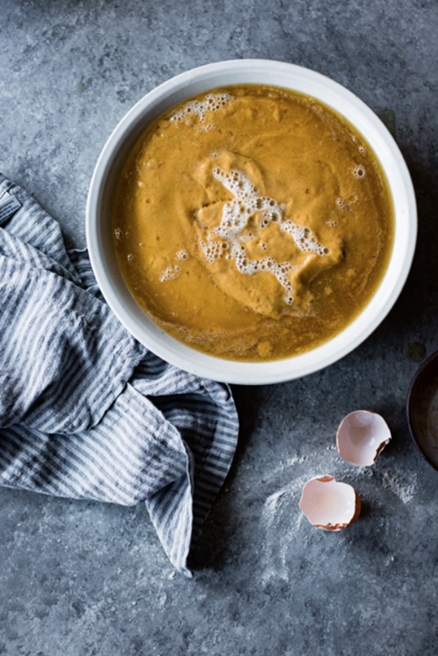
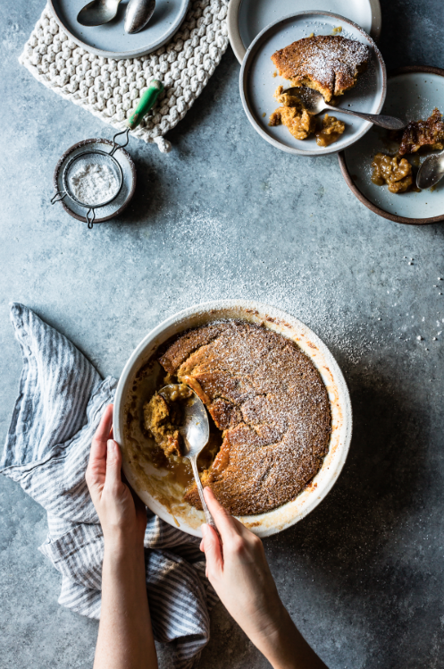

Slide 22
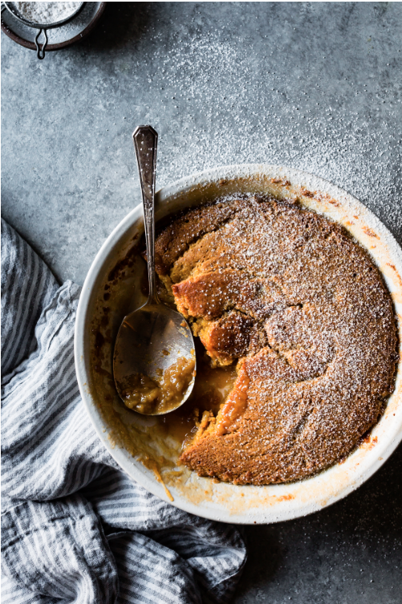
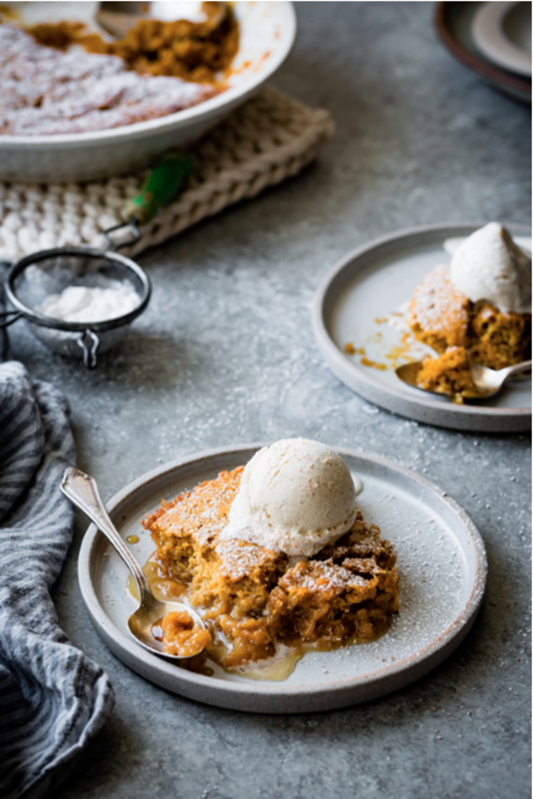

Slide 23
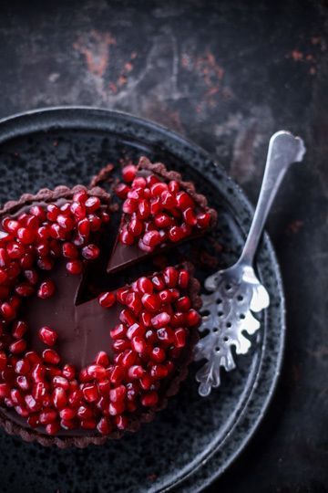
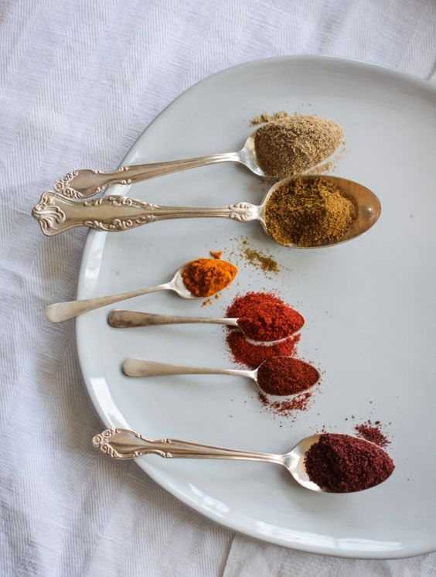

Slide 24
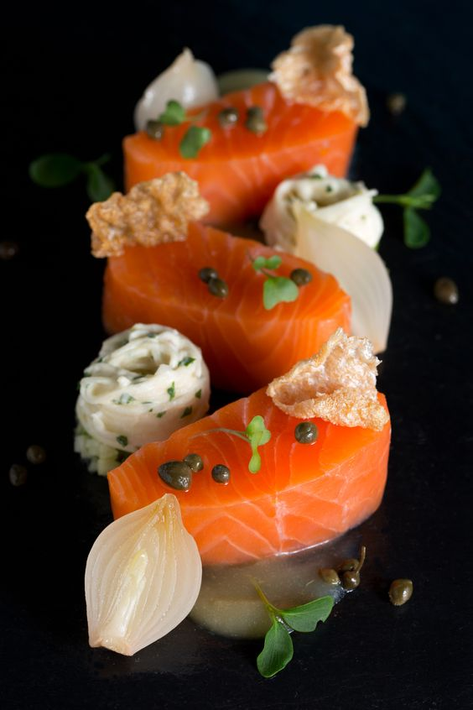
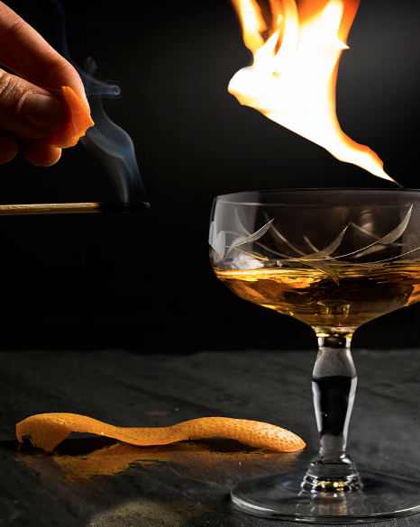

Slide 25
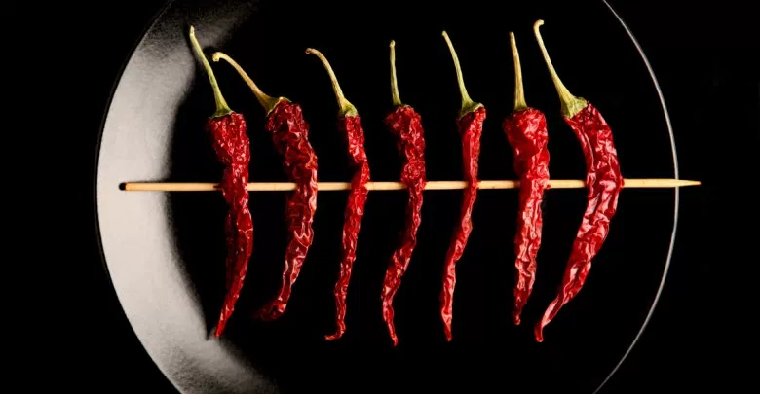

Slide 26
Work Cited
https://en.wikipedia.org/wiki/Food_photography
https://www.bls.gov/oes/current/oes274021.htm#nat
http://work.chron.com/starting-wage-food-photographer-20279.html
https://www.payscale.com/research/US/Job=Photographer/Salary
https://study.com/articles/Food_Photographer_Job_Description_and_Career_Roadmap.html
http://www.learnfoodphotography.com/eofp-lesson-1/
https://www.youtube.com/watch?v=IjvS4v2JVWo
https://petapixel.com/2016/03/24/photos-show-secret-tricks-food-photography/
https://www.creativereview.co.uk/trends-modern-food-photography/?mm_5a70b8524da92=5a70b8524db35
http://bojongourmet.com/2017/11/gluten-free-maple-pumpkin-pudding-chomeur/
http://www.vault.com/industries-professions/professions/f/food-photographers.aspx
https://www.photocontestinsider.com/2016/03/what-does-a-food-photographer-do/

